Slide 1

MasterCom DevOps Platform Demo
High Performance capability and Financial Strength
rating by
NSIC-D&B-SMERA

Slide 2
What is DevOps?
DevOps is a software development approach which involves continuous development, continuous testing, continuous integration, continuous deployment and continuous monitoring of the software throughout its development life cycle

Slide 3
What is CICD Pipeline?
CI stands for Continuous Integration and CD stands for Continuous Delivery and Continuous Deployment

Slide 4
Tools Used
Jenkins
An open source continuous Integration tool which provides hundreds of plugins to support building, deploying and automating any project
Gitlab
Gitlab is a SCM(source code management) tool to maintain source code
SonarQube
Continuous inspection of code quality with static analysis of code to detect bugs, code smells and security vulnerabilities
Artifactory
It is a Binary Repository Manager used to manage storage of artifacts generated
Jira
Lifecycle management tool to capture user requirements as user stories and It is used for bug tracking, issue tracking, and project management

Slide 5
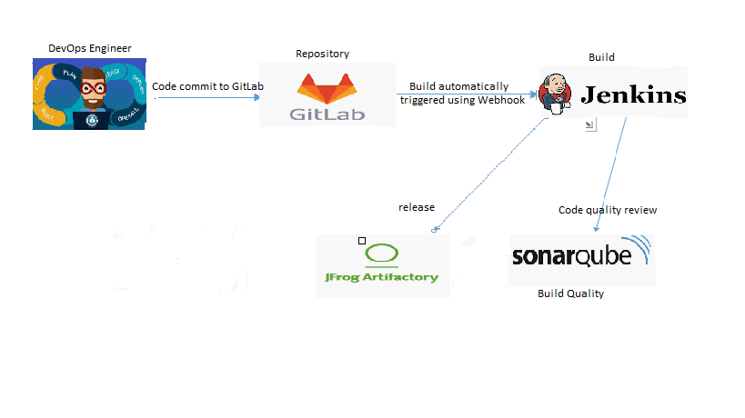
Demo Flow Diagram:
1
2
4
3

Slide 6
Thank you!
MasterCom Platform Engineering Team
janaki.c@mastercom.co.in
srivinesh.s@mastercom.co.in
tushar.k@mastercom.co.in

